Slide 1

IT Infrastructure Management Chapter 2: Key concepts of service management TY B.Sc. (IT)
Semester VI
Poornima .N
Assistant Professor, Department of IT/CS
1

Slide 2

3 Topics:
Value and value co-creation
Organizations, service providers, service consumers, and other stakeholders
Products and services
Service relationships
Value: outcomes, costs, and risks.

Slide 3

4 Value
The perceived benefits, usefulness, and importance of something.
Value can be subjective.

Slide 4
5 Value co-creation
Value is co-created through active collaboration between providers and consumers.
📘 Earlier: Provider → Consumer (one-way) 📘 Now: Provider 🤝 Consumer (collaboration)

Slide 5
6 Organizations and Stakeholders
An organization is a person or group of people that has its own functions and objectives.
Service Provider: Offers services
Service Consumer: Uses services
Other Stakeholders: Partners, employees, regulators, shareholders

Slide 6
7 Service Providers and Consumers
📘 Service Provider: Organization delivering services
📘 Service Consumer: Organization or person using services
🔹 Roles of Service Consumer:
User → uses the service
Customer → defines needs
Sponsor → approves budget

Slide 7
8 Products and Services
📘 Product: Configuration of resources designed to offer value
📘 Service: A means of enabling value co-creation by facilitating outcomes without managing specific costs or risks
Example:
“Lite” version → individual users
“Pro” version → corporate users

Slide 8
9 Service Offerings
A service offering is a formal description of one or more services, designed to meet the needs of a target consumer group.
It’s how the organization says, “Here’s what we provide, who it’s for, and how it meets your needs.”

Slide 9
10 Example: Food Delivery App (like Swiggy / Zomato)
1. Goods: 🍔 The food prepared and packed by the restaurant.
2. Access to Resources: 📱 The mobile app that lets users browse restaurants, place orders, and track delivery.
3. Service Actions: 🚴 Delivery by riders and customer support for order issues.

Slide 10
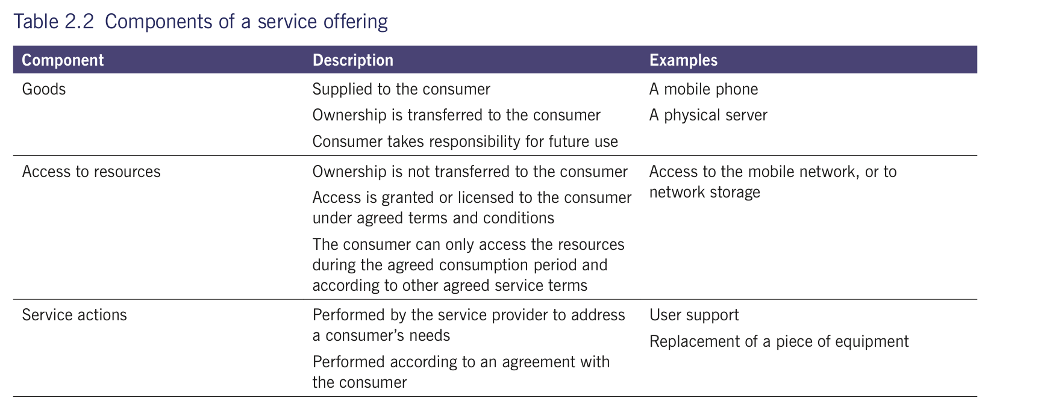

Slide 11
11 Service Relationships
Cooperation between provider and consumer to co-create value.
Includes:
Service Provision – delivering the service
Service Consumption – using the service
Service Relationship Management – ensuring ongoing collaboration

Slide 12
12 Example: Cloud Storage Service (like Google Drive)
Service Provision: ☁️ Google provides online storage space, backup, and data security.
2. Service Consumption: 👩‍💻 Users upload, store, and share their files using the service.
3. Service Relationship Management: 💬 Google offers support, updates, and ensures service quality — while users give feedback or report issues.

Slide 13
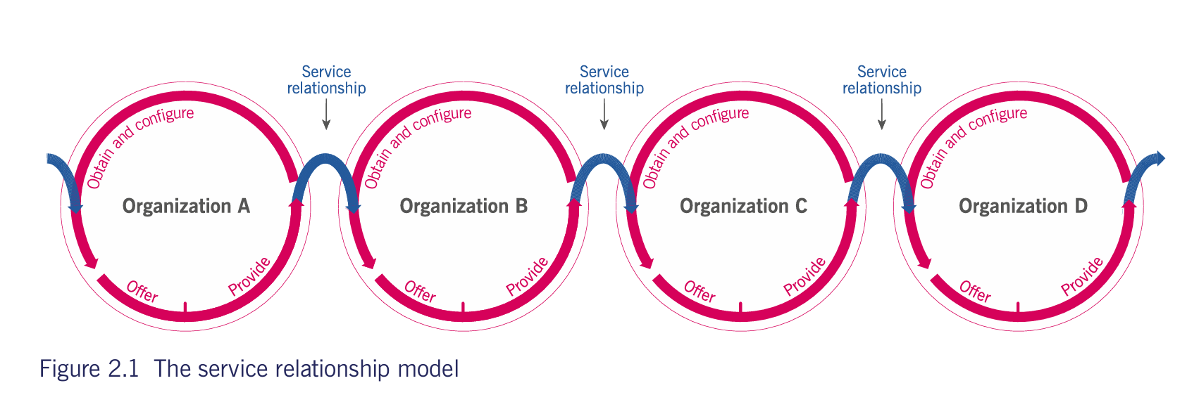

Slide 14
12 Value: Outcomes, Costs, and Risks
📘 Value is realized when: ✔ Desired outcomes are achieved ❌ Costs and risks are reduced
💡 Formula: Value = Outcomes Achieved – (Costs + Risks)

Slide 15
13 Outcomes
Service providers create outputs that help consumers achieve desired outcomes.
Output: Deliverable from an activity (e.g. photo album)
Outcome: Result achieved by outputs (e.g. preserved memories)
Outputs ≠ Outcomes

Slide 16
14 Costs
Amount of money spent on an activity or resource.
From Consumer Perspective:
Costs removed by service (e.g. no staff, no hardware cost)
Costs imposed by service (e.g. subscription, training cost)
From Provider Perspective:
Understand total cost to deliver service within budget.

Slide 17
15 Risks
A possible event causing harm, loss, or uncertainty in achieving objectives.
From Consumer Perspective:
Risks removed by service (e.g. reduced system failure risk)
Risks imposed by service (e.g. security breach, provider failure)
Shared Responsibility:
Provider manages operational risks.
Consumer helps by defining outcomes, success factors & providing resources.

Slide 18
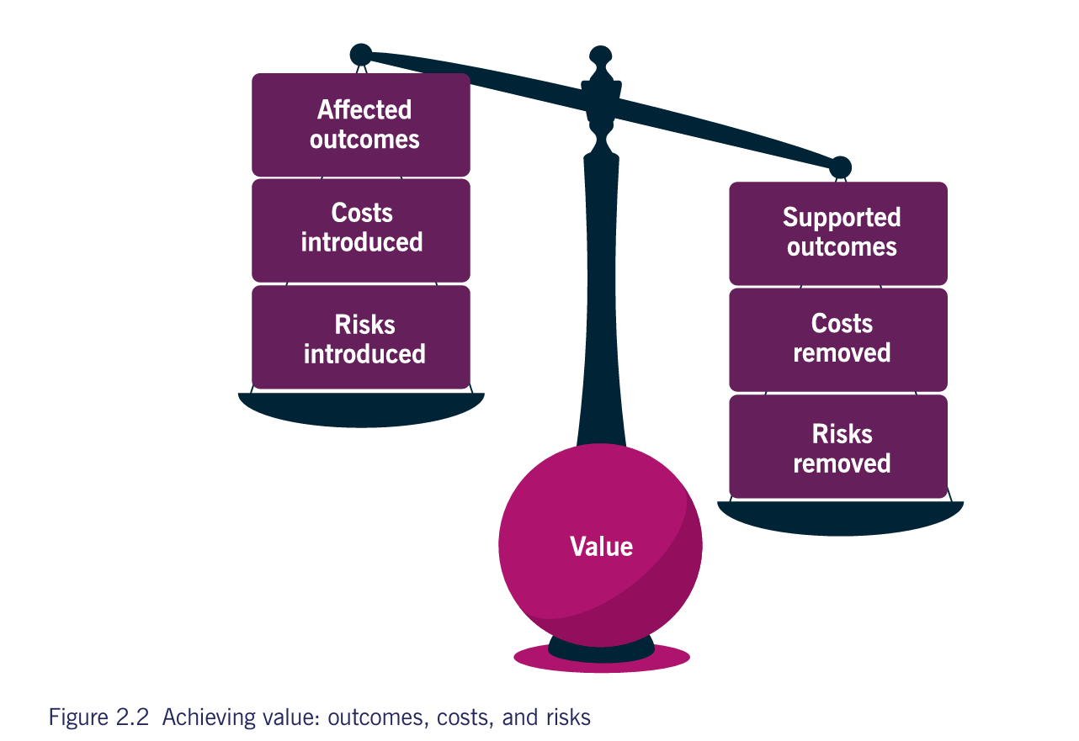

Slide 19
16 EXAMPLE
Aspect | What happens | Effect on Value
✅ Supported Outcome | I can access files anywhere | ↑ Increases value
💸 Cost Removed | I don’t need to buy servers | ↑ Increases value
🔒 Risk Removed | Provider handles data backup | ↑ Increases value
⚠️ Affected Outcome | Slightly slower upload speed | ↓ Reduces value
💰 Cost Introduced | I pay a monthly subscription | ↓ Reduces value
❗ Risk Introduced | If provider fails, I lose access | ↓ Reduces value

Slide 20
17 Utility and Warranty
When we judge whether a service truly gives value to the consumer, we check two things:
Utility → What the service does Warranty → How the service performs
Both must be present for the service to create real value.

Slide 21
18 Utility does the service meet the purpose?
Utility is about the functionality.
Example: In a theme park, the rides that deliver thrills and fun = utility. If the rides are exciting and entertaining → the service is fit for purpose.

Slide 22
19 Warranty does it work reliably, safely, and consistently?
Warranty is about the assurance
Warranty deals with:
Availability ,Capacity ,Security and Continuity
Example: In the theme park, if rides are working properly, open on time, and safe → that’s warranty. If rides break down often → the service is not fit for use.

Slide 23
20 Utility + Warranty = Value
Scenario | Utility | Warranty | Value
Exciting rides, but often closed | ✅ | ❌ | ❌ Poor value
Always working rides, but boring | ❌ | ✅ | ❌ Poor value
Exciting + reliable rides | ✅ | ✅ | ✅ Great value
Utility gives the reason to use the service, Warranty gives the confidence to rely on it.

Slide 24
21 Examples
Example | Utility (What it does) | Warranty (How it performs)
Wi-Fi service | Lets you connect to the internet | Must be available, stable, and secure
Online banking app | Enables money transfers & balance check | Must work reliably, securely, 24/7
Theme park | Offers thrilling experiences | Must have safe, working rides
Laptop | Runs applications efficiently | Should not crash, overheat, or lag

Slide 25

Thank you…

